Slide 1
High Resolution PM_{2.5} Modeling
Student: Joey Hotz
Professor: Meredith Franklin

Slide 2
Research Goals and Objectives
The main objective of this research project is to predict the daily concentrations of air pollutants such as PM_{2.5} in the United States using machine learning models.
These “fine inhalable particles” are important in medical contexts, but the concentrations of these particles are often not recorded on a daily basis.
To accomplish this goal, we will fit different ‘classes’ of predictive models (e.g. linear models, simple vector machines, gradient boosted trees) to our dataset to determine which models yield the best predictive performance.
The main metrics which we will use to evaluate model performance are the RMSE and R² of the predicted values for the test set.

Slide 3
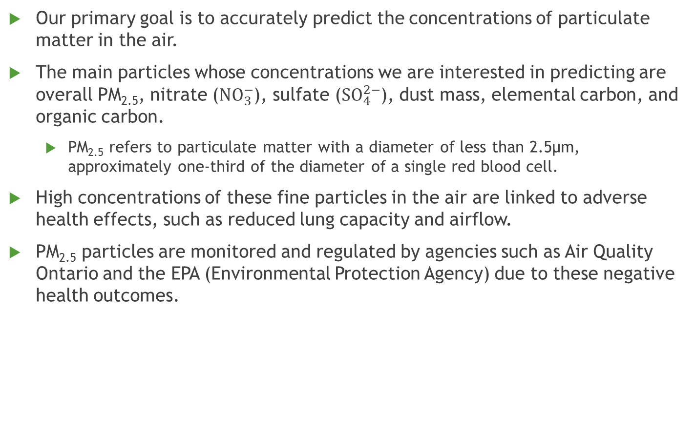
Scientific Context
Our primary goal is to accurately predict the concentrations of particulate matter in the air.
The main particles whose concentrations we are interested in predicting are overall PM_{2.5}, nitrate (${NO}_{3}^{−}$), sulfate (${SO}_{4}^{2−}$), dust mass, elemental carbon, and organic carbon.
PM_{2.5} refers to particulate matter with a diameter of less than 2.5μm, approximately one-third of the diameter of a single red blood cell.
High concentrations of these fine particles in the air are linked to adverse health effects, such as reduced lung capacity and airflow.
PM_{2.5} particles are monitored and regulated by agencies such as Air Quality Ontario and the EPA (Environmental Protection Agency) due to these negative health outcomes.

Slide 4
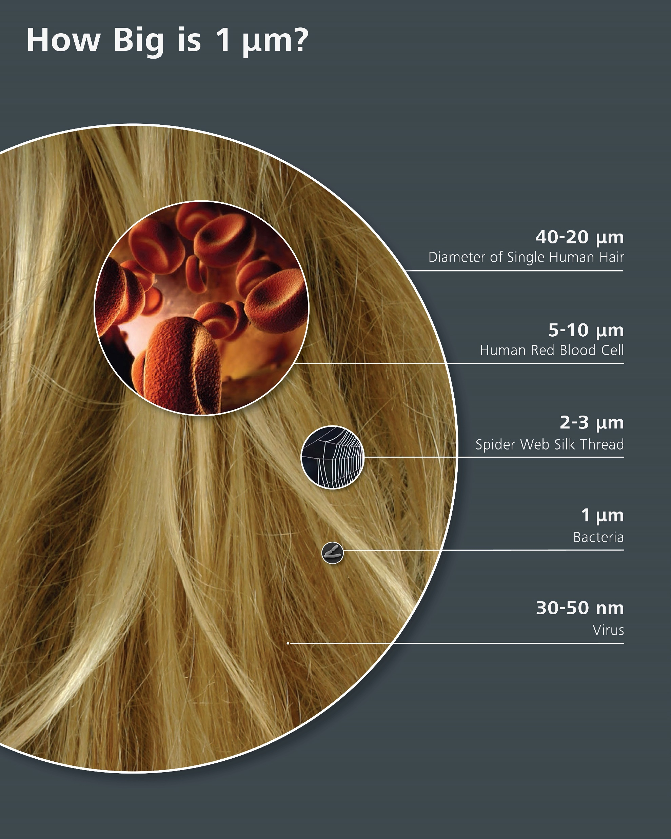
Notes:
Image Source: https://www.flickr.com/photos/zeissmicro/10690468113/

Slide 5
Data Sources
There are five primary sources of the data which we used for predicting the concentrations of fine airborne particles:
AQS (Air Quality System), which measures PM_{2.5} concentrations at many sites across the United States approximately twice per week.
CSN (Chemical Speciation Network), which measures weather conditions and concentrations of various atoms and compounds every three to six days.
CASTNET (Clean Air Status and Trend Network), which measures sulfate and nitrate concentrations approximately once per week.
IMPROVE (Interagency Monitoring of Protected Visual Environments), which measures sulfate and nitrate concentrations approximately twice per week.
MISR (Multi-Angle Imaging Spectroradiometer), an Earth-orbiting satellite equipped with cameras which measures the concentrations of aerosols in a 4.4 km grid.
Of these five sources of data, the first four are measured on the ground, whereas the MISR data is based on images taken overhead from space.

Slide 6
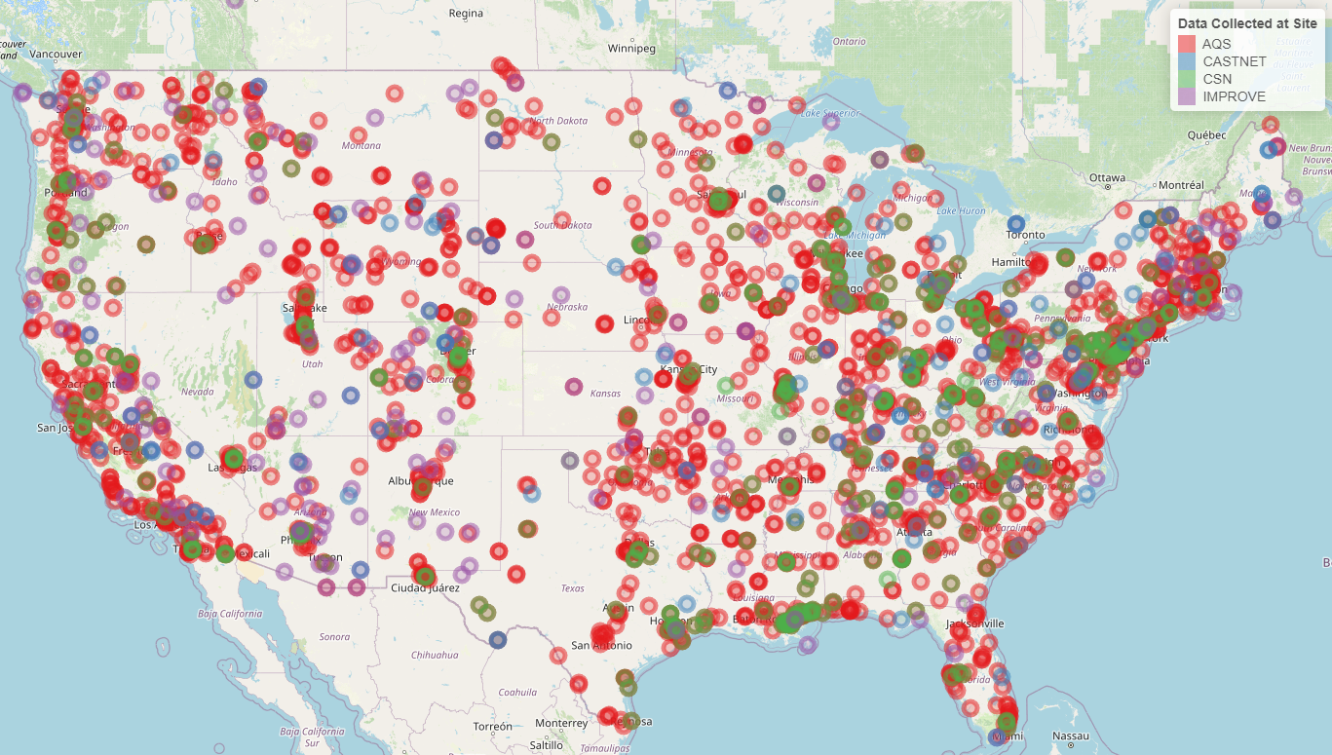
Notes:
Image Source: https://www.flickr.com/photos/zeissmicro/10690468113/

Slide 7
Model Selection Procedure
To compile our dataset, we used spatial matching to combine observations taken at sites on the ground with observations from the MISR dataset.
There were no CASTNET or IMPROVE data sites in California which were sufficiently close to observations from the MISR dataset.
After the data was combined, we cleaned the data to account for abnormalities in the dataset (such as negative concentrations of particles) and filtered out observations with missing data.
We used different combinations of variables as potential predictors in our models,
To fit our models, we utilized a 70/15/15 split to partition our datasets into training, validation, and testing datasets.
The validation dataset was used for tuning the hyperparameters for fitting certain classes of models.

Slide 8
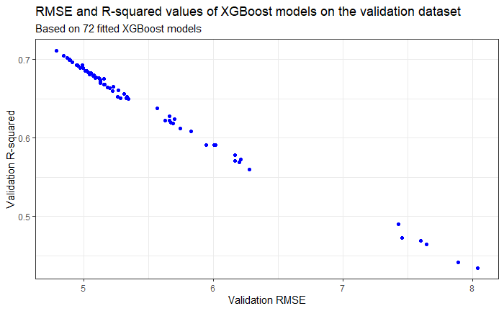
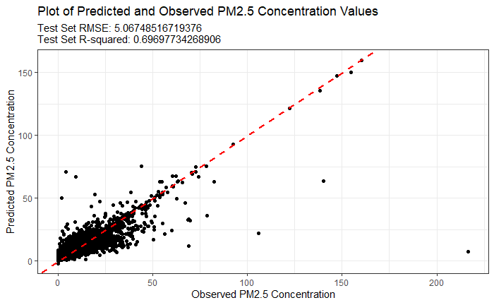
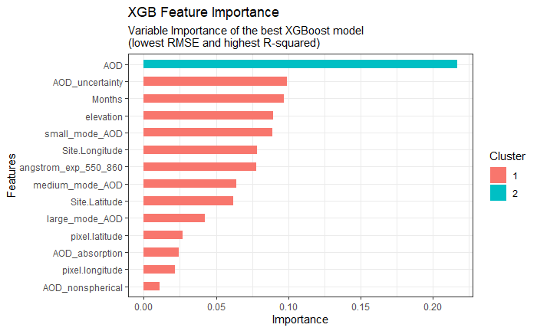
Notes:
Image Source: https://www.flickr.com/photos/zeissmicro/10690468113/

Slide 9
Model Selection Procedure
To compile our dataset, we used spatial matching to combine observations taken at sites on the ground with observations from the MISR dataset.
There were no CASTNET or IMPROVE data sites in California which were sufficiently close to observations from the MISR dataset.
After the data was combined, we cleaned the data to account for abnormalities in the dataset (such as negative concentrations of particles) and filtered out observations with missing data.
We used different combinations of variables as potential predictors in our models,
To fit our models, we utilized a 70/15/15 split to partition our datasets into training, validation, and testing datasets.
The validation dataset was used for tuning the hyperparameters for fitting certain classes of models.

